Slide 1

File Manager (Python)
Aliaskar Mukazhanov CS-2111

Slide 2

Preparing libraries

Slide 3
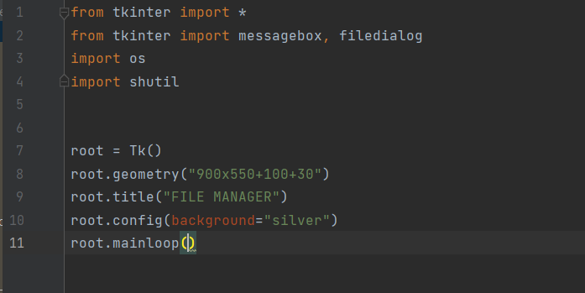
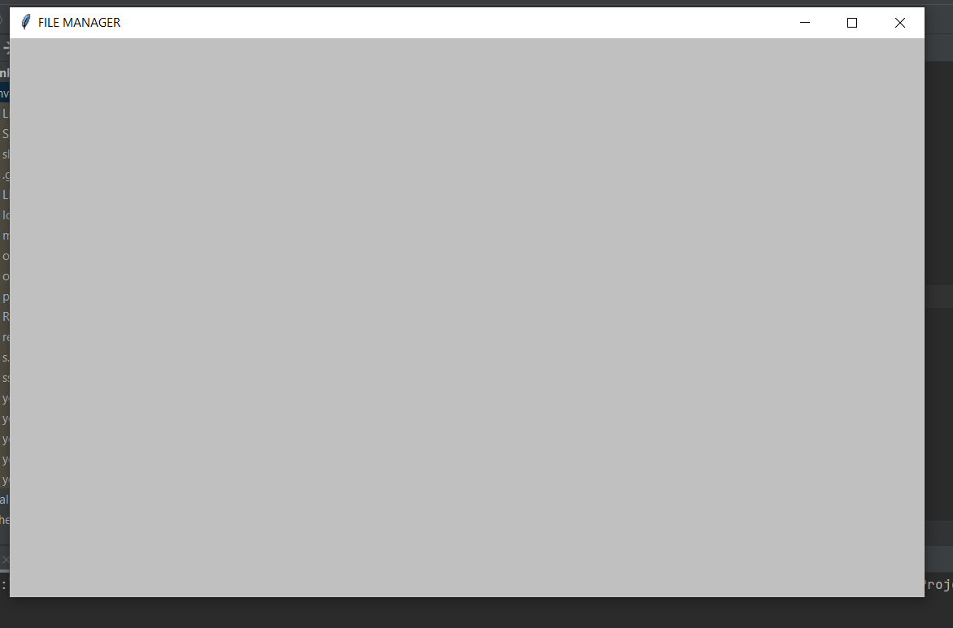
Creating window

Slide 4


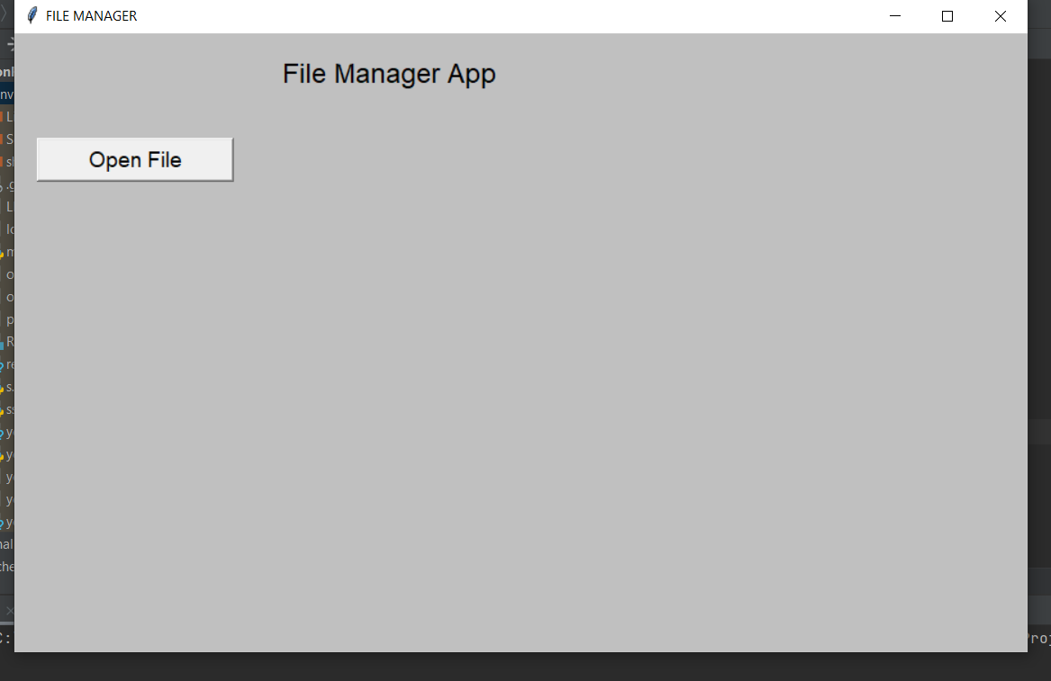
Creating functions (open file)

Slide 5
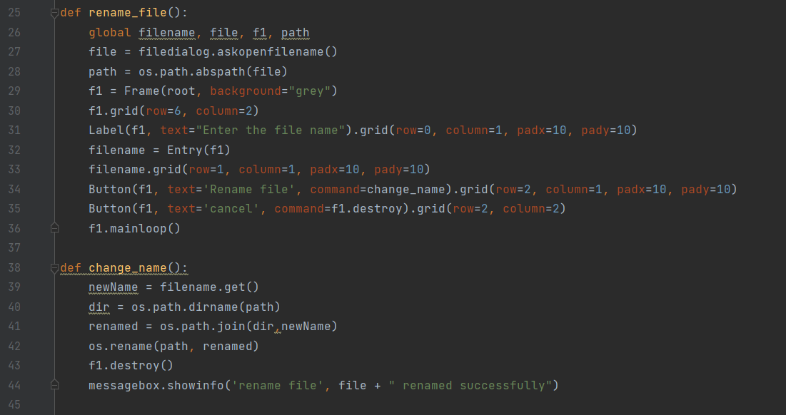
Creating functions (rename file)

Slide 6
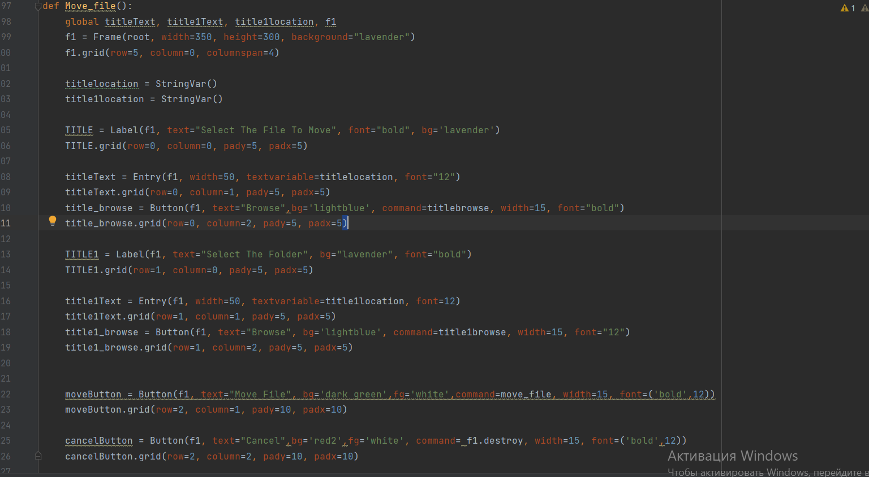
Creating function (move file) p1

Slide 7
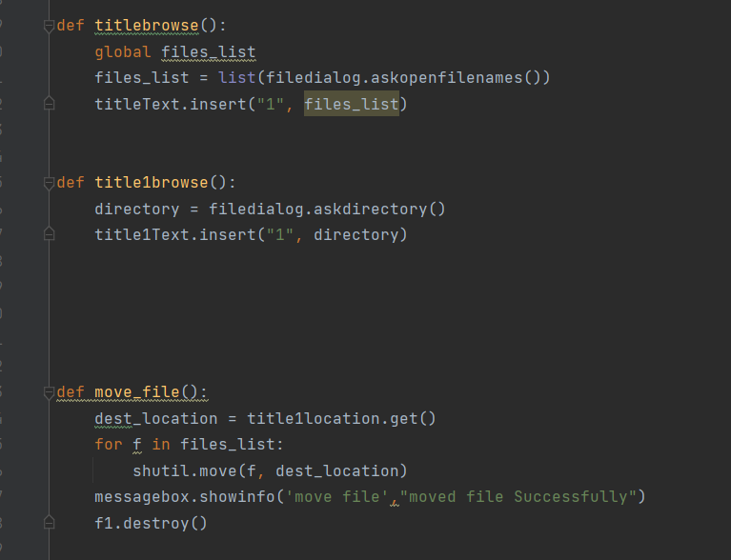
Creating function (move file) p2 (end)

Slide 8
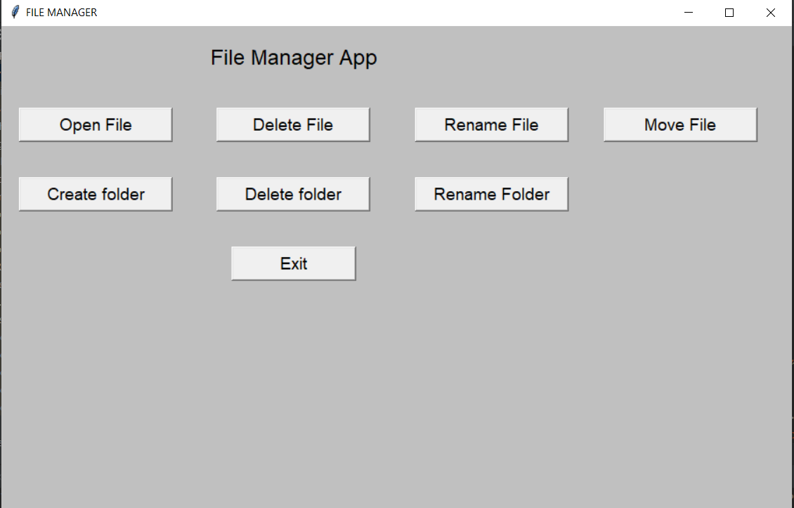
Result

